Slide 1

Introduction to trees
Module 4 part 4: BST operations

Slide 2
BST
Definition: A tree T is called as a Binary Search Tree if each node N of T has the following property, The value at N is greater than every value in the left subtree of N and is less than every value in the right subtree of N.
root
root
15
12
22
BST
BST
7
13
16
23
Left-subtree
(Lesser)
Right-subtree
(Greater)

Slide 3
Construct a BST
10, 12, 5, 4, 20, 8, 7, 15, 13

Slide 4
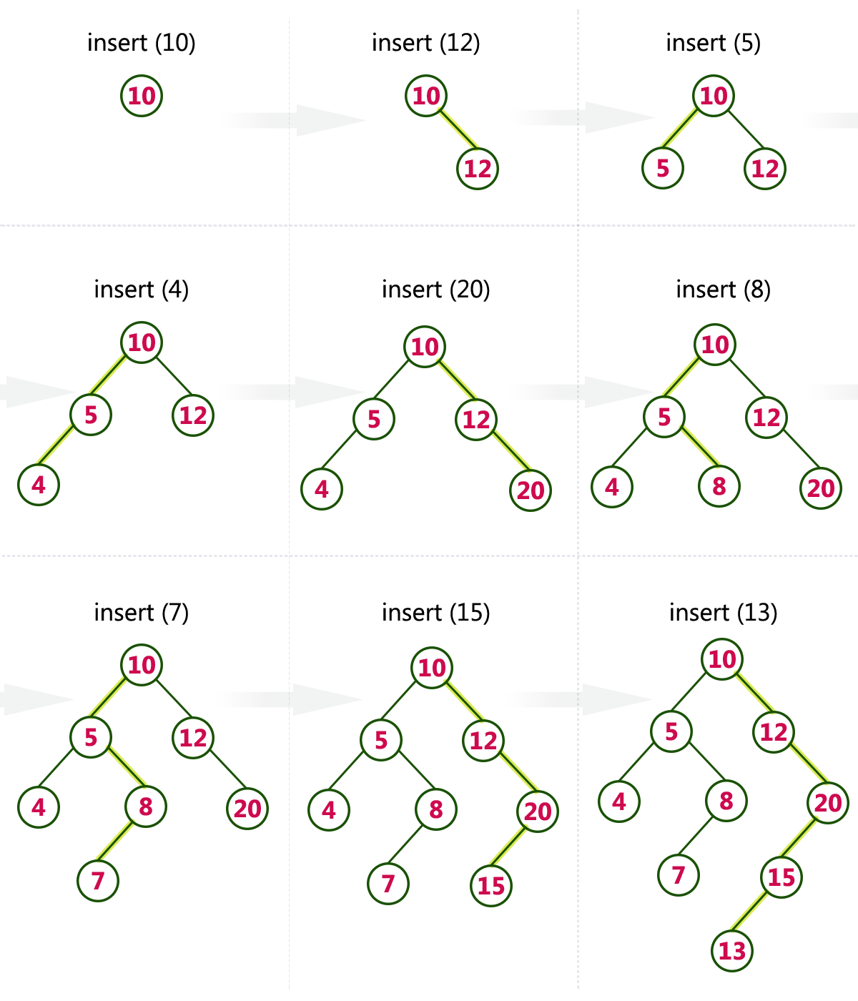
BST Example

Slide 5
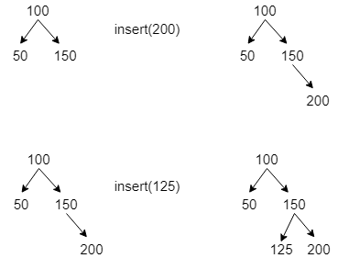
Insert 200 and 125 in the following tree

Slide 6
Binary Search Tree Implementation
16
9
19
16
8
11
18
20
9
19
8
11
18
20
Linked representation of Binary tree

Slide 7
Insertion in BST
The following Algorithm finds the location of ITEM in BST T or inserts ITEM as a new node in its appropriate place in the tree
Algorithm Insert_BST(Node, ITEM)
Step 1.
i) If root == NULL,
return the new node to the calling function.
ii) if root=>data < ITEM
root->right = insert_BST(root=>right, ITEM)
//call the insert function with root=>right and assign the return value in root=>right.
iii) if root=>data > ITEM
root=>left = insert_BST(root=>left,ITEM)
// call the insert function with root->left and assign the return value in root=>left.
Step 2. Finally, return the original root pointer to the calling function.

Slide 8
Insertion in BST-sample code
struct Bstnode *insert(struct node *root, int val)
{
if(root == NULL)
return getNewNode(val);
if(root->key < val)
root->right = insert(root->right,val);
else if(root-> key > val)
root->left = insert(root->left,val);
return root;
}

Slide 9
Insertion in BST-sample code-cntd..
struct Bstnode
{
int key;
struct Bstnode *left;
struct Bstnode *right;
};
100
int main()
{
struct Bstnode *root = NULL;
root = insert(root,100);
root = insert(root,50);
root = insert(root,150);
root = insert(root,60)
preorder(root);
return 0;
}
root
50
150
500
500
60
600
100
700
600
NULL
50
800
NULL
150
NULL
800
NULL
60
NULL

Slide 10
void preorder(struct node *root)
{
if(root == NULL)
return;
printf("%d ",root->key);
preorder(root->left);
preorder(root->right);
}
Preorder(root)
root
500
500
600
100
700
600
left
key
right
NULL
50
800
NULL
150
NULL
800
NULL
60
NULL

Slide 11
Tracing of preorder traversal function
500
600
preorder(NULL)
{
if(root == NULL) True
return;
printf("%d ",root->key); 60
preorder(root->left);
preorder(root->right);
}
void preorder(struct node *root )
{
if(root == NULL)
return;
→ printf("%d ",root->key); //100
preorder(root->left);
preorder(root->right);
}
→ preorder(root)
{
if(root == NULL)
return;
printf("%d ",root->key); //50
preorder(root->left); →
preorder(root->right); →
}
preorder(800)
{
if(root == NULL)
return;
printf("%d ",root->key); // 60
preorder(root->left);
preorder(root->right);
}
→ preorder(700)
{
if(root == NULL)
return;
printf("%d ",root->key); //150
preorder(root->left);
preorder(root->right);
}

Slide 12
Deleting a node from BST
Leaf node: If the node is leaf (both left and right will be NULL), remove the node directly and free its memory.
Example
100 100
/ \ / \
50 200 delete(300) 50 200
/ \ /
150 300 150

Slide 13
Deleting a node from BST-cntd..
Node with right child: If the node has only right child (left will be NuLL), make node points to the right node and free the node
Example
100 100
/ \ / \
50 200 delete(200) 50 300
\
300

Slide 14
Deleting a node from BST-cntd..
Node with left child: If the node has only left child (right will be NULL), make the node points to the left node and free the node
Example
100 100
/ \ / \
50 200 delete(200) 50 150
/
150

Slide 15
Deleting a node from BST-cntd..
Node has both left and right child: If the node has both left and right child,
1.find the smallest node in the right subtree. say min
2.make node->data = min
3.Again delete the min node.
(step 2) (step 3)
100 100 100
/ \ / \ / \
50 200 delete(200) 50 300 50 300
/ \ (right subtree min = 300) / \ /
150 300 (step 1) 150 300 150

Slide 16
END

